Slide 1
Computer Programming
Loops in c
Subtitle: Understanding Iterative Constructs in C
Dhruv Manchanda
25BCA10305

Slide 2
Introduction
What are Loops?
Loops are used to execute a block of code repeatedly.
They simplify repetitive tasks and reduce code redundancy.
Types of loops in C
For loop
While loop
Do-while loop

Slide 3
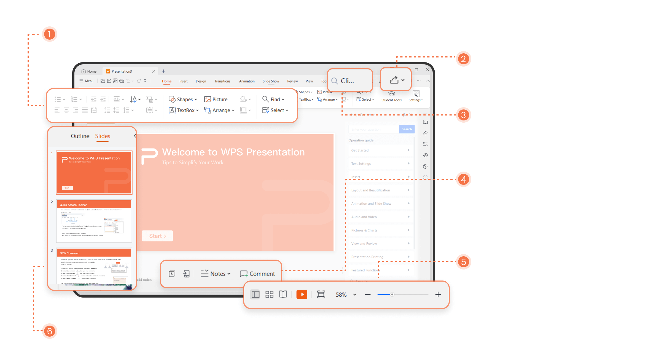
Types of loops
.
For loop
Syntax: for(initialization; condition; increment/decrement)
Example: for(int i = 0; i < 10; i++) { printf("%d", i); }
Use Case: When the number of iterations is known.
Syntax: while(condition) { // code }
Example: while(x > 0) { x--; }
Use Case: When the condition is checked before execution.
While loop

Slide 4
Comparison of Loops
For loop
Condition checking happens before loop
On use case there are known iterations
While loop
Condition checking happens before loop
On use case there are unknown iterations

Slide 5
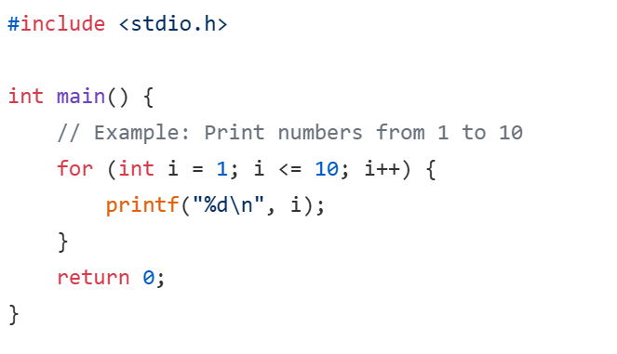
Code for For Loop
Explanation:
Initialization (int i = 1): The loop starts with i initialized to 1.
Condition (i <= 10): The loop runs as long as i is less than or equal to 10.
Increment (i++): After each iteration, i is incremented by 1

Slide 6
Case study
Understanding the for Loop and Its Use Cases
123
A for loop is a control flow statement used in programming to execute a block of code repeatedly. It is particularly useful when the number of iterations is known beforehand or when iterating over a sequence like a list, range, or string. The loop consists of three main components: initialization, condition, and increment/decrement.
Syntax and Working of a for Loop
The general syntax of a for loop varies across programming languages but typically follows this structure:
for variable in sequence:
# Code to execute
Copy
In languages like C or Java, the syntax includes initialization, condition, and increment:
for (initialization; condition; increment) {
// Code to execute
}
opy
The loop works as follows:
Initialization: A variable is initialized to control the loop.
Condition: The loop checks a condition before each iteration. If true, the loop body executes; otherwise, it terminates
Increment/Decrement: The control variable is updated after each iteration.

Slide 7
Advantages of loops
1.Code Reusability
Loops allow you to execute the same block of code multiple times without rewriting it.
This reduces redundancy and makes programs shorter and cleaner.
2. Automation of Repetitive Tasks
Tasks that require repeated execution (e.g., printing numbers, processing arrays) can be automated.
Saves time and effort compared to writing the same statements repeatedly.
3. Easy Maintenance
If you need to change the logic, you only modify it in one place inside the loop instead of multiple places in the code.
4. Dynamic Execution
Loops can run based on runtime conditions (e.g., user input, sensor data, file contents).
This makes programs more flexible and adaptable.
5. Efficient Memory Usage
Instead of storing multiple copies of similar code, loops reuse the same instructions, reducing program size.
6. Supports Complex Iterations
Loops can be nested to handle multi-dimensional data structures like matrices.
They can also be combined with conditions for advanced control flow.

Slide 8
Loop Control Statements
break – Exit loop immediately.
continue – Skip current iteration.
goto – Jump to a labeled statement (use with caution).

